Slide 1
Employee Data Analysis using Excel
STUDENT NAME: G.PAVITHRA
REGISTER NO: UNM143922CZ-A53
DEPARTMENT: COMMERCE(B.COM(GENERAL)).
COLLEGE : SHREE CHANDRAPRABHU JAIN COLLEGE.

Slide 2

PROJECT TITLE
Employee Performance Analysis using Excel

Slide 3


AGENDA
Problem Statement
Project Overview
End Users
Our Solution and Proposition
Dataset Description
Modelling Approach
Results and Discussion
Conclusion
3/21/2024 Annual Review

Slide 4

PROBLEM STATEMENT
Inconsistent employee performance data.
Identifying patterns.
Employees metrics.
Decision making.
Actionable insights.
1. Mathematics: Problems involving algebra, calculus, geometry, etc. 2. Programming: Coding challenges, algorithms, data structures, etc. 3. Business: Case studies, strategic planning problems, etc. 4. Science: Physics, chemistry, biology problems, etc.

Slide 5
PROJECT OVERVIEW
ᴄᴏɴᴛᴇɴᴛ:
AIM ; To streamline employee daya analysis using excel tools.
OBJECTIVES; Identify key metrics,analyze trends & provide data -driven insights.
1. Project Title: A concise name for the project. 2. Project Purpose: A brief description of why the project is being undertaken. This includes the problem it aims to solve or the opportunity it seeks to leverage. 3. Objectives: Specific goals that the project aims to achieve. Objectives should be SMART (Specific, Measurable, Achievable, Relevant, Time-bound). 4. Scope: Defines what is included and excluded from the project. It outlines the boundaries and limits of the project work. 5. Key Deliverables: Major outputs or results that the project is expected to produce. Deliverables should be clear and measurable. 6. Timeline: A high-level schedule including major milestones and deadlines. This section might include a Gantt chart or a timeline diagram. 7. Budget: An overview of the financial resources allocated to the project. This includes estimated costs and funding sources. 8. Stakeholders: Key individuals or groups involved in or affected by the project. This includes the project sponsor, team members, and any other relevant parties. 9. Assumptions and Constraints: Key assumptions that the project

Slide 6

WHO ARE THE END USERS?
HR managers
Term leads & departments helds.
Company exectives company manager.

Slide 7

OUR SOLUTION AND ITS VALUE PROPOSITION
CONTENT:
✦ Implement excel-based data analysis techniques.
✦Generate automated reports and dashboards.
✦ Enable easy data manipulation and visualization.

Slide 8
Dataset Description
Content:
☆ Data collected from employee records, including performance, attendance, & demographics.
☆Number of revotds,time span & key variables.

Slide 9
MODELLING
CONTENT:
~Data cleaning and preprocessing.
~ Using excel functions for statistical analysis.
~Visualization using excel charts and pivot tables.
9

Slide 10

THE "WOW" IN OUR SOLUTION
CONTENT:
Automated reporting : our excel based system automates complex reporting tasks,saving HR managers hours of manual work. Tise enables quick access to insightful data without the neat for extensive excel expertise.
3/21/2024 Annual Review
10

Slide 11
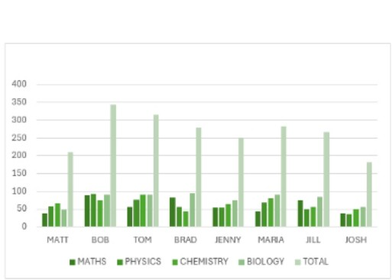
RESULTS
11

Slide 12
conclusion
CONTENT:
Summary of insights gained.
Impact on decision making and employee management.
Future steps for further analysis or implementation.

